Slide 1
Evaluation of RAG-Based Applications
Workshop
Nadav Barak
Head of AI
Deepchecks

Slide 2



The Use Case
Application providing responses for general purpose questions based on internet search.
A classic RAG setup.
User Question
Intent Detection
Rephrasing
Retrieval
Document Search
Embedding Based Reranking
Answer
Single LLM Call with few shot & instructions

Slide 3
The Task
Curated evaluation set of ~80 samples which were manually annotated.
Our goal is to develop an automated evaluation pipeline.
This pipeline would be used to evaluate future versions and production data.
Notes:
Based on https://huggingface.co/datasets/neural-bridge/rag-dataset-12000
What an automated evaluation pipeline mean?

Slide 4
Automated Evaluation Pipeline
Code takes a sample (input, context, LLM output) and returns whether the output is correct.
With a representative test set, we can measure the LLM-based application performance.
Key questions:
What makes a good automated evaluation pipeline?
How do we define and measure success?

Slide 5
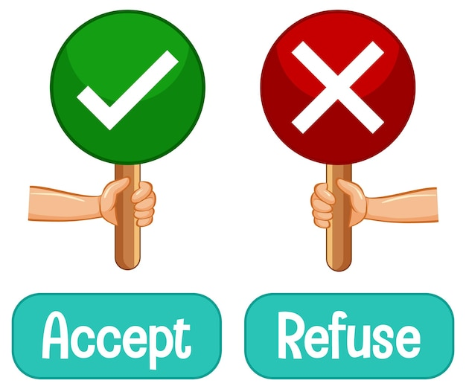
Step 1 - Define Evaluation Criteria
What could make an answer problematic or incorrect?
Review the data. Focus on annotation reasoning.
Come up with few top criteria.

Slide 6
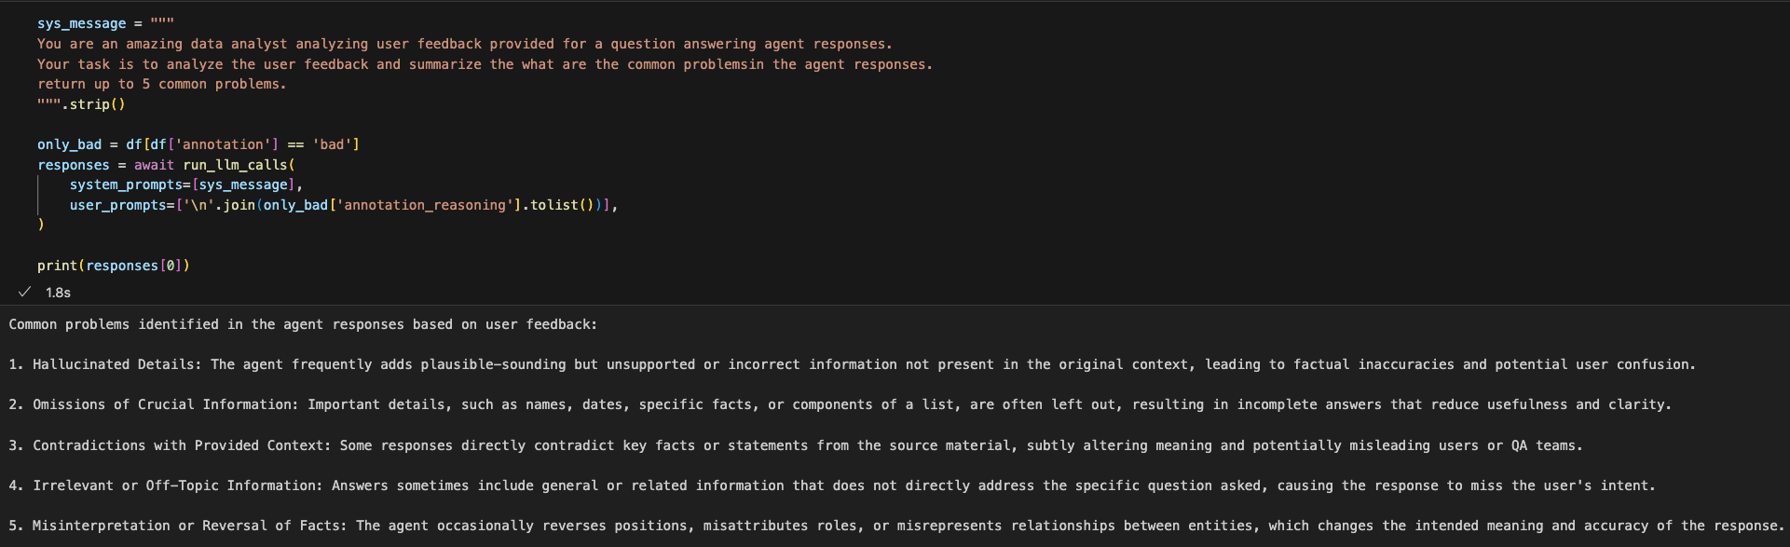
Step 1 - Automatic Analysis
Would focus on the following criteria:
Completeness, Relevance, Hallucinations, Contradictions

Slide 7
Step 2 - Implement Key Basic Properties
Completeness
Does the output provide a complete solution?
Relevance
Does the output directly address the user question?
Select a relevant metric (and data) to measure.
Start with a base-line and improve from it.

Slide 8
Step 2 - Completeness Solution
Use a subset for evaluating!
Samples marked as bad due to completeness, good samples.
Start with a naïve solution with a well defined metric you aim to maximize – ROC AUC.
Iteratively improve.
OpenAI Cookbook
Multi step process / Multiple judges

Slide 9
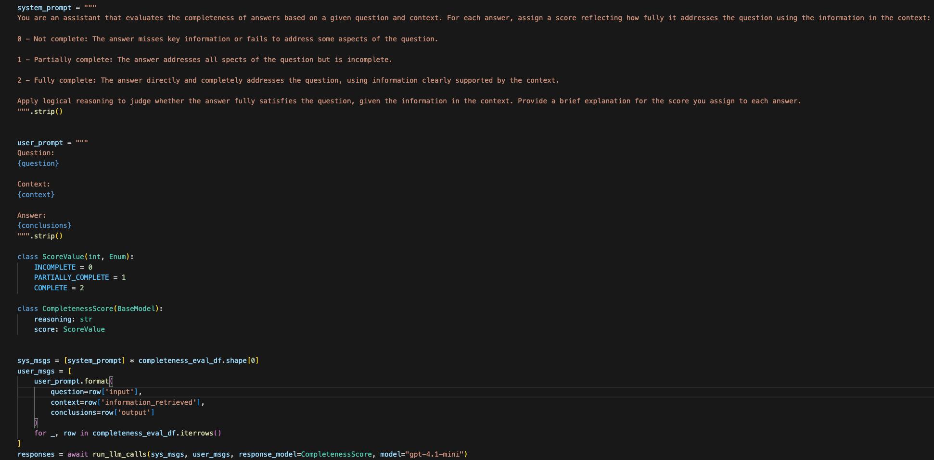
Step 2 - Completeness Solution

Slide 10
Step 3 - Grounded in Context (Hallucinations)
Whether the output contain information which is not based on the information retrieval document.
Why is this the correct definition?
The information retrieval is usually long.
A common output contains multiple facts.
In problematic outputs, some are not grounded.
Different facts are based on different paragraphs.

Slide 11
Step 3 - Grounded in Context Implementation
Split the output into facts.
Split by sentences
Advanced: Use llm to extract the facts
Split the document into chunks.
Langchain’s Text Splitter (Pay close attention to parameters!)
LLM with structured output
Model to infer grounding of (paragraph,fact) pair.
NLI model
Advanced: Other models, LLM.
Score Aggregation .

Slide 12
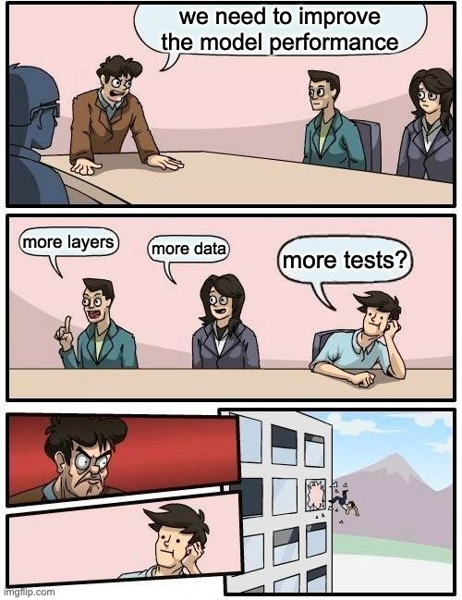

Thank you for listening, and may the tests be with you
Our Docs!
Notes:
On a final note – I would like to use this opportunity to both say thank you, and also to encourage your feedback and suggestions.
We feel that the incredible pace at which this package is growing and being adopted, is greatly thanks to the valuable help & feedback that we’ve been receiving from the community. If this package is going to be used by everyone, which I hope it will, we will need a ton of help getting there. So please feel free to reach out to me to contribute, to give your ideas, to let me know how you are using it, or for anything else.
--
Thank you for your time, and I wish you peaceful validations and positive test results (when desired…)

